Slide 1




Towards Efficient SpMV on Sunway Many-core Architectures
Changxi Liu, Biwei Xie, Xin Liu, Wei Xue, Hailong Yang, Xu Liu
Notes:
Good afternoon, everyone. I am Liu Changxi from Beihang University.
Today, I will introduce our work, Towards Efficient SpMV on Sunway Many-core Architecture.
This is a joint work with ict , College of Willam and Mary, Tsinghua University and National supercomputing center in Wuxi.

Slide 2
Outline
Background & Motivation
SpMV
Sunway Architecture
Proposed Method
Dual-side multi-level partition mechanism
Example for illustration
Evaluation
SpMV Performance
Locality
Conclusion
Notes:
The presentation is organized as 4 sections.
I will introduce the background, including SpMV and Sunway.
And then, we will present our method and the experimental result.

Slide 3

SpMV (Sparse Matrix-vector multiplication)
SpMV is an essential kernel
Notes:
Sparse problems are very common in many workloads from HPC, machine learning, and graph computing. Among them, SpMV plays an essential role.

Slide 4
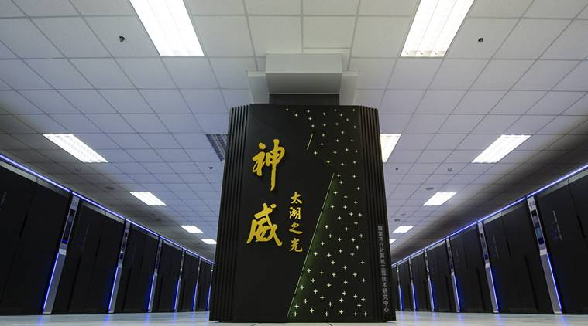

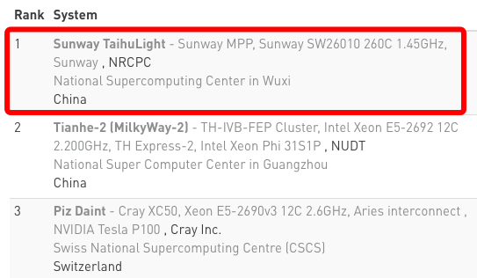

Sunway powers TaihuLight
SW26010
# cores | 260
Peak Performance | 3.06 Tflops (DP)
Memory Bandwidth | 136.5 GB/s
Compute / Memory | 22 flops/byte
Memory | 32 GB
[1] https://www.top500.org
Notes:
There are a lot of super computers in our world. Among them, Sunway is an important platform. Sunway TaihuLight have ranked as the first place in top500 list since 2016 to 2018. It also gains ACM Gordon Bell Prize twice.
The processor of sunway is sw26010, a many core RISC processor.
The configuration of SW26010 is shown in this table.

Slide 5
SpMV on Sunway Processor
SpMV
Sunway Processor
What is challenging for implementing high performance SpMV on Sunway processor?
Notes:
So, it is significant to implement an efficient SpmV on Sunway. As we take our first step to do it. We should figure out firstly what is challenging for implementing high performance SpMV on Sunway architecture?

Slide 6
SpMV on Sunway Processor
SpMV
Sunway Processor
What is challenging for implementing high performance SpMV on Sunway processor?
Notes:
To understand it, we should know the challenge in SpMV at first.

Slide 7
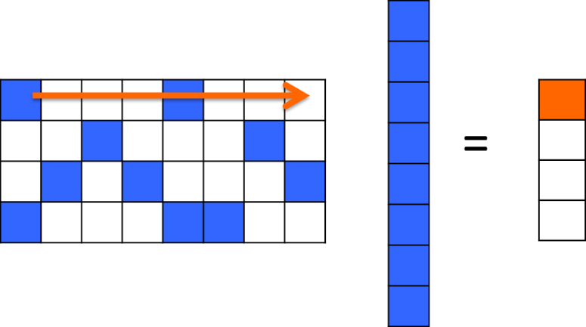
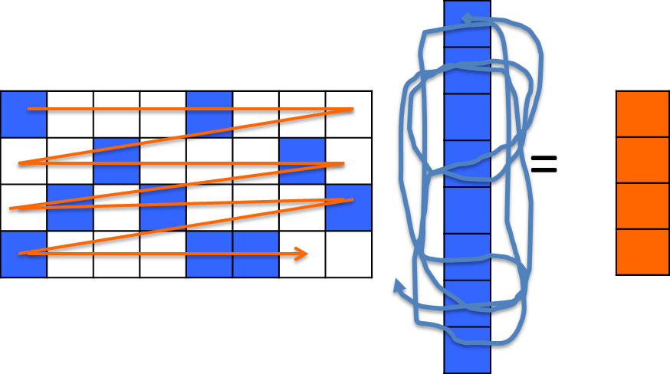
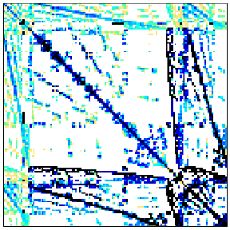
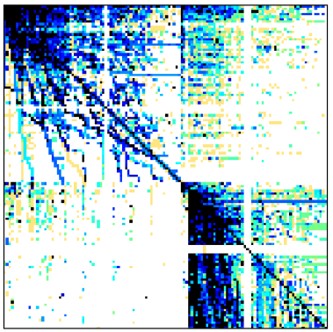
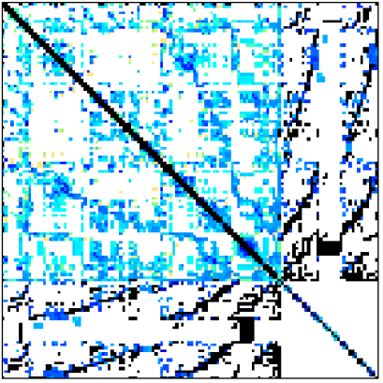
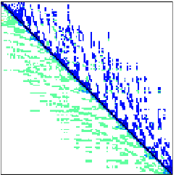
Performance Analysis of SpMV
x
x
Sparse Matrix A
Vector y
Vector x
Irregular memory access
Poor Locality
Write Conflict
Storage Format of Matrix A
CSR
ELLPACK ^{[Choi et. al, PPoPP10]}
CSR5 ^{[Liu et. al, ICS15]}
…
crankseg_2
webbase-1M
2cubes_sphere
cage14
Notes:
When sparse matrix A multiply with vector x.
The memory access pattern of vector x is random.
It depends on the distribution of no-zero elements in sparse matrices
The irregular memory access causes a lot of problems, like poor locality and write conflict.
To solve those problems, there are a lot of storage formats proposed, like CSR,ELLPACK,CSR5 and so on.
Proposed,locality

Slide 8
SpMV on Sunway Processor
SpMV
Sunway Processor
What is challenging for implementing high performance SpMV on Sunway processor?
Notes:
After the analysis of SpmV, let’s now take a look at the underlying architecture: Sunway
analysis

Slide 9
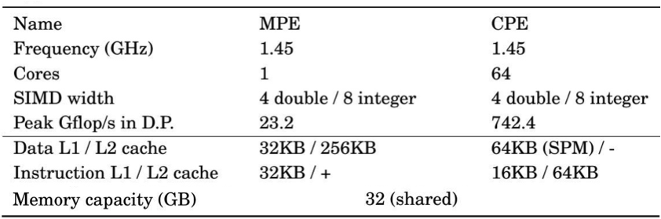
SW26010 Processor
M
e
m
or
y
M
e
m
or
y
iM
C
C
or
iM
C
e
G
r
ou
p
0
C
or
e
G
r
ou
p
1
M
e
m
or
y
L
e
ve
8*8
CP
E
Mes
h
l
C
om
p
u
PPU
PPU
t
i
n
g
R
ow
C
or
e
C
om
m
u
n
i
c
at
i
Bu
on
8*8
CP
E
8*8
CP
E
s
MP
E
Mes
MP
E
h
Mes
h
L
D
M
L
e
ve
R
l
e
gi
s
t
e
r
s
SPM
D
at
a T
N
oC
r
an
s
f
e
r
N
e
t
LD
M
w
or
k
MP
E
8*8
CP
E
8*8
CP
E
MP
E
R
e
gi
s
t
e
r
L
e
ve
Mes
l
h
Mes
T
h
r
an
s
f
e
r
A
ge
n
t
(
T
A
)
PPU
PPU
C
on
t
r
ol
C
ol
u
m
n
iM
C
C
or
iM
C
e
G
r
C
or
ou
p
3
e
G
r
N
e
ou
p
2
t
w
or
k
C
om
m
u
n
i
c
at
i
on
B
u
s
C
om
p
u
t
i
n
g L
e
ve
M
l
e
m
or
y
M
e
m
or
y
Notes:
Here is the architecture of SW processor.
Each processor has four core groups (CGs). We short the core group as CG.
The peak performance of each CG is about 800 GFLOPS in double precision with a theoretical memory bandwidth of 34 GB/s
Each CG includes one management processing element and one computing processing element cluster. We short the former as MPE and the latter one as CPE cluster. There are 64 CPEs in one CG and these 64 CPEs are organized as an 8*8 mesh.

Slide 10
SW26010 Processor
M
e
m
or
y
M
e
m
or
y
iM
C
C
or
iM
C
e
G
r
ou
p
0
C
or
e
G
r
ou
p
1
M
e
m
or
y
L
e
ve
8*8
CP
E
Mes
h
l
C
om
p
u
PPU
PPU
t
i
n
g
R
ow
C
or
e
C
om
m
u
n
i
c
at
i
Bu
on
8*8
CP
E
8*8
CP
E
s
MP
E
Mes
MP
E
h
Mes
h
L
D
M
L
e
ve
R
l
e
gi
s
t
e
r
s
SPM
D
at
a T
N
oC
r
an
s
f
e
r
N
e
t
LD
M
w
or
k
MP
E
8*8
CP
E
8*8
CP
E
MP
E
R
e
gi
s
t
e
r
L
e
ve
Mes
l
h
Mes
T
h
r
an
s
f
e
r
A
ge
n
t
(
T
A
)
PPU
PPU
C
on
t
r
ol
C
ol
u
m
n
iM
C
C
or
iM
C
e
G
r
C
or
ou
p
3
e
G
r
N
e
ou
p
2
t
w
or
k
C
om
m
u
n
i
c
at
i
on
B
u
s
C
om
p
u
t
i
n
g L
e
ve
M
l
e
m
or
y
M
e
m
or
y
MPE (Management Processing Element)
Management, task schedule, data communication
CPEs (Computing Processing Elements)
Just for Computing
Notes:
The MPE and CPEs always serve different roles during the computation. The MPE does well in handling the management, task schedule, and data communications.
The CPE is designed just for computing.

Slide 11
SW26010 Processor
M
e
m
or
y
M
e
m
or
y
iM
C
C
or
iM
C
e
G
r
ou
p
0
C
or
e
G
r
ou
p
1
M
e
m
or
y
L
e
ve
8*8
CP
E
Mes
h
l
C
om
p
u
PPU
PPU
t
i
n
g
R
ow
C
or
e
C
om
m
u
n
i
c
at
i
Bu
on
8*8
CP
E
8*8
CP
E
s
MP
E
Mes
MP
E
h
Mes
h
L
D
M
L
e
ve
R
l
e
gi
s
t
e
r
s
SPM
D
at
a T
N
oC
r
an
s
f
e
r
N
e
t
LD
M
w
or
k
MP
E
8*8
CP
E
8*8
CP
E
MP
E
R
e
gi
s
t
e
r
L
e
ve
Mes
l
h
Mes
T
h
r
an
s
f
e
r
A
ge
n
t
(
T
A
)
PPU
PPU
C
on
t
r
ol
C
ol
u
m
n
iM
C
C
or
iM
C
e
G
r
C
or
ou
p
3
e
G
r
N
e
ou
p
2
t
w
or
k
C
om
m
u
n
i
c
at
i
on
B
u
s
C
om
p
u
t
i
n
g L
e
ve
M
l
e
m
or
y
M
e
m
or
y
CPEs: many-core architecture
Notes:
There are three features we should know about CPEs
It is many-core architecture
features

Slide 12
SW26010 Processor
M
e
m
or
y
M
e
m
or
y
iM
C
C
or
iM
C
e
G
r
ou
p
0
C
or
e
G
r
ou
p
1
M
e
m
or
y
L
e
ve
8*8
CP
E
Mes
h
l
C
om
p
u
PPU
PPU
t
i
n
g
R
ow
C
or
e
C
om
m
u
n
i
c
at
i
Bu
on
8*8
CP
E
8*8
CP
E
s
MP
E
Mes
MP
E
h
Mes
h
L
D
M
L
e
ve
R
l
e
gi
s
t
e
r
s
SPM
D
at
a T
N
oC
r
an
s
f
e
r
N
e
t
LD
M
w
or
k
MP
E
8*8
CP
E
8*8
CP
E
MP
E
R
e
gi
s
t
e
r
L
e
ve
Mes
l
h
Mes
T
h
r
an
s
f
e
r
A
ge
n
t
(
T
A
)
PPU
PPU
C
on
t
r
ol
C
ol
u
m
n
iM
C
C
or
iM
C
e
G
r
C
or
ou
p
3
e
G
r
N
e
ou
p
2
t
w
or
k
C
om
m
u
n
i
c
at
i
on
B
u
s
C
om
p
u
t
i
n
g L
e
ve
M
l
e
m
or
y
M
e
m
or
y
CPEs: many-cores architecture
Register communication: by row or column
Notes:
CPEs in the same row or column can communicate with each other.

Slide 13
SW26010 Processor
M
e
m
or
y
M
e
m
or
y
iM
C
C
or
iM
C
e
G
r
ou
p
0
C
or
e
G
r
ou
p
1
M
e
m
or
y
L
e
ve
8*8
CP
E
Mes
h
l
C
om
p
u
PPU
PPU
t
i
n
g
R
ow
C
or
e
C
om
m
u
n
i
c
at
i
Bu
on
8*8
CP
E
8*8
CP
E
s
MP
E
Mes
MP
E
h
Mes
h
L
D
M
L
e
ve
R
l
e
gi
s
t
e
r
s
SPM
D
at
a T
N
oC
r
an
s
f
e
r
N
e
t
LD
M
w
or
k
MP
E
8*8
CP
E
8*8
CP
E
MP
E
R
e
gi
s
t
e
r
L
e
ve
Mes
l
h
Mes
T
h
r
an
s
f
e
r
A
ge
n
t
(
T
A
)
PPU
PPU
C
on
t
r
ol
C
ol
u
m
n
iM
C
C
or
iM
C
e
G
r
C
or
ou
p
3
e
G
r
N
e
ou
p
2
t
w
or
k
C
om
m
u
n
i
c
at
i
on
B
u
s
C
om
p
u
t
i
n
g L
e
ve
M
l
e
m
or
y
M
e
m
or
y
CPEs: many-cores architecture
Register communication: by row or column
Memory access:
LDM (High bandwidth), which prefers continuous data loading
Notes:
The memory controller supports two kinds of memory access:
Direct memory access
Each CPE has a 64KB local device memory.
We short the local device memory, LDM, which is a little similar with the share memory on GPU, needs manual controlling.
DMA can get the data from memory to LDM. And CPE can reuse the data in LDM. It prefers continuous data loading and high bandwidth.
Supports prefers

Slide 14
SW26010 Processor
M
e
m
or
y
M
e
m
or
y
iM
C
C
or
iM
C
e
G
r
ou
p
0
C
or
e
G
r
ou
p
1
M
e
m
or
y
L
e
ve
8*8
CP
E
Mes
h
l
C
om
p
u
PPU
PPU
t
i
n
g
R
ow
C
or
e
C
om
m
u
n
i
c
at
i
Bu
on
8*8
CP
E
8*8
CP
E
s
MP
E
Mes
MP
E
h
Mes
h
L
D
M
L
e
ve
R
l
e
gi
s
t
e
r
s
SPM
D
at
a T
N
oC
r
an
s
f
e
r
N
e
t
LD
M
w
or
k
MP
E
8*8
CP
E
8*8
CP
E
MP
E
R
e
gi
s
t
e
r
L
e
ve
Mes
l
h
Mes
T
h
r
an
s
f
e
r
A
ge
n
t
(
T
A
)
PPU
PPU
C
on
t
r
ol
C
ol
u
m
n
iM
C
C
or
iM
C
e
G
r
C
or
ou
p
3
e
G
r
N
e
ou
p
2
t
w
or
k
C
om
m
u
n
i
c
at
i
on
B
u
s
C
om
p
u
t
i
n
g L
e
ve
M
l
e
m
or
y
M
e
m
or
y
CPEs: many-cores architecture
Register communication: by row or column
Memory access:
LDM (High bandwidth), which prefers continuous data loading
Gload/Gstore (low bandwidth), which prefers random data loading
Notes:
global load and global store. Which prefer random data loading. It can fetch data from memory directly. But its bandwidth is low

Slide 15
SpMV on Sunway Processor
Irregular memory access
Poor Locality
Write Conflict
Sunway Architecture
Many-core
Register communication
LDM
How to exploit the architecture features for SpMV
Notes:
As so far, we have known that SpMV have irregular memory access problem
We also grasp some features of Sunway, like many cores, Register communication, LDM and so on.
So , how to explore the architecture features for SPMV

Slide 16

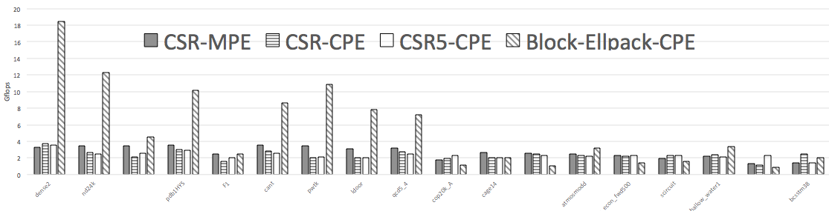
SpMV on Sunway Processor
Notes:
Let’s take a look at existing spmv methods. The performance of their naive implementation is quite low.
Most of them achieves less than 6 gflops. They can not fit well on sunway architecture.

Slide 17

SpMV on Sunway Processor
A new SpMV method on Sunway is motivated
Notes:
So, a new SpMV method on Sunway is motivated

Slide 18
Outline
Background & Motivation
SpMV
Sunway Architecture
Proposed Method
Dual-side multi-level partition mechanism
Example for illustration
Evaluation
SpMV Performance
Locality
Conclusion
Notes:
Now, I will introduce our method, Dual-side multi-level partition mechanism

Slide 19
Design Overview
Vector x
Vector y
Sparse Matrix A
Sunway (64 Cores)
Partition for locality
Partition rows for vector y
Partition cols for vector x
One row as a unit
Register communication
Reduce memory traffic
Dual-side and multi-level partition mechanism
BT-CSR: first implementation of SpMV on Sunway
Notes:
Before we present our method. We want to show the design overview of our method.
We do partition for locality. The partition rows for vector y and partition column for vector x.
We set a row as a unit to utilize the register communication mechanism on sunway. And by using this feature, we can reduce the memory traffic.
Based on them, we design a dual-side and multi-level partition mechanism. This mechanism can help , porting existing SpMV methods to Sunway architecture.
Here we take CSR for an example.by applying this mechanism on CSR, we propose BT-CSR. It’s the first implementation of SpMV on Sunway.

Slide 20
Dual-side multi-level partition mechanism
Level 0
CPEs consist of fleets
Matrix consists of blocks
block
tile
slice
Computation core
I/O core
Notes:
There are 64 cores in a CG. We should organize them to solve the SpMV problem. As the cores in the same row or column can communicate with each other directly,
We set the cores in the same row as a fleet.
Accordingly, we divide the matrix into blocks.
The cores in the same fleet will work together to conduct the computing block by block.

Slide 21
Dual-side multi-level partition mechanism
Level 0
CPEs consists of fleets
Matrix consists of blocks
Level 1
Fleet consists of
Computation cores
I/O core
Block consists of tiles
block
tile
slice
Computation core
I/O core
Notes:
In level 1 , as all cores cooperate to process a block, we specify a core as I/O core to handle the reduction of vector y.
The other cores are classified as computation cores. They are responsible to load matrix data and vector x and conduct the computing.
A block will be further divided into tiles
The computation cores conduct the computing tile by tile.

Slide 22
Dual-side multi-level partition mechanism
Level 0
CPEs consists of fleets
Matrix consists of blocks
Level 1
Fleet consists of
Computation cores
I/O core
Block consists of tiles
Level 2
Computation cores cooperate with I/O core
Tile consists of slices
block
tile
slice
Computation core
I/O core
Notes:
In level 2 , the computation cores process tiles independently. They will send the result of a tile to the I/O core.
A tile will then be divided into slices

Slide 23
Dual-side multi-level partition mechanism
Level 0
CPEs consists of fleets
Matrix consists of blocks
Level 1
Fleet consists of
Computation cores
I/O core
Block consists of tiles
Level 2
Computation cores cooperate with I/O core
Tile consists of slices
Level 3
Slice is the basic computation unit
All levels form the dual-side multi-level partition mechanism
Notes:
In level 3,
The unit of computation is slice.
The computation core will send a message, each time it finishes a slice
This is our design of 3 level partition mechanism from both sides of spmv and sunway processor
Now, We will introduce each level in detail.

Slide 24
Level 1: Block-Fleet Mapping
Map
The CPEs on Sunway can be divided into 8 fleets
Fleets work independently to process blocks
The height of a block is θ, which determines the buffer size of vector y
Notes:
Level 1 maps the block to the fleet. We split 64 cores in sunway processor to 8 fleets. They are working independently to process block. When a block has been processed completed, the fleet will get another block until there is no block in task queue. The height of a block is θ. There are M/θ blocks in the task queue. The value of θ fits the buffer size of vector y in I/O core
queue

Slide 25
Level 2: Tile-Core Mapping
Map
The computation cores and I/O core cooperate to process tiles
The computation cores produce the results of tiles independently
The I/O core performs reduction on the results from computation cores
The height of a tile is same as the block
The width of a tile is δ, which determines the buffer size of vector x
Notes:
As we have talked about the mechanism of level 1. Let go down into level2 to see how a fleet deal with a block. Level 2 build a tile-core mapping. To exploit the benefit of register communication, we set a core in the fleet to be I/O core. The remaining cores in the fleet is used as computation Core. Computation cores conduct the computing of tiles independently. The I/O core performs reduction on the results from computation cores. When the computation core finishes a tile, it will get another tile from task queue until there is no tile left. The height of a tile is same as the block. The non-zero elements in a tile share the same vector x buffer. The buffer size of x vector is delta. How to choose the value of it is complex. Please refer to our paper for details.

Slide 26
Level 3: Slice Computation
Map
The computation core sends a message when the calculation of a slice is completed
The height of a slice is ω, which fits the message size of register communication
Slice is a basic computation unit in our method
Notes:
In level 2, we have known that the reduction is performed on I/O core. But how?
The computation core sends a message when the calculation of a slice is completed. The size of a slice is limited by the message size of register communication. We set the height of a slice to ω to fit the message size.
In our implementation on sunway, slice is the basic computation unit.
Now, we know the details of our method already.
We will further give an example to elaborate the cooperation between the computation cores and the I/O core .

Slide 27
Example
C0
C1
C2
C3
C4
C5
C6
C7
Get x(δ)
Reg
Reg
Reg
Reg
LDM
LDM
Buffer
(LDM)
● ● ●
Sparse Matrix A
Vector y (θ)
Vector x (δ)
v1
Notes:
firstly ,we get a subset of vector x from the memory. We name it as v1.

Slide 28
Example
C0
C1
C2
C3
C4
C5
C6
C7
Get x(δ)
Get slice
Reg
Reg
Reg
Reg
LDM
v1
LDM
Buffer
(LDM)
● ● ●
Sparse Matrix A
s1
Vector y (θ)
Vector x (δ)
Notes:
Then a slice is sent to LDM from memory. We name it as s1

Slide 29
Example
×
msg1
C0
C1
C2
C3
C4
C5
C6
C7
Get x(δ)
Get slice
Compute
Reg
Reg
Reg
Reg
LDM
v1
s1
LDM
Buffer
(LDM)
● ● ●
Sparse Matrix A
slice
Vector y (θ)
Vector x (δ)
Notes:
As v1 and s1 are loaded into LDM, we multiply them and store the result into msg1

Slide 30
Example
C0
C1
C2
C3
C4
C5
C6
C7
Get x(δ)
Get slice
Compute
Send message
Reg
Msg1
Reg
LDM
LDM
LDM
Buffer
(LDM)
● ● ●
Sparse Matrix A
slice
Vector y (θ)
Vector x (δ)
Notes:
The msg1 is stored in a register when the computation finished. We send it to I/O core(C7) , and the I/O conduct the reduction of msg1 into vector y.

Slide 31
Example
C0
C1
C2
C3
C4
C5
C6
C7
Get x(δ)
Get slice
Compute
Send message
Parallel processing
Reg
Reg
Msg0
Reg
Msg
Msg1
Reg
LDM
Msg2
LDM
LDM
Msg1+
Msg2+
Msg3
● ● ●
Sparse Matrix A
tile0
tile1
tile2
Vector y (θ)
Vector x (δ)
v0
v1
v2
Notes:
In actually, the computation cores process parallelly.
And I/O core do the reduction of the result from computation cores, and the we will get the result, y(theta)

Slide 32
Example – Write result to vector y
C0
C1
C2
C3
C4
C5
C6
C7
Get x(δ)
Get slice
Compute
Send message
Parallel Processing
Write y (θ)
Reg
Reg
Reg
Msg
Reg
LDM
LDM
LDM
y (θ)
● ● ●
θ
Sparse Matrix A
slice
Vector y (θ)
Vector x (δ)
Notes:
When a block is finished, I/O core will write y(θ) back to memory. And they will process the next block until there is no block in task queue.

Slide 33
Outline
Background & Motivation
SpMV
Sunway Architecture
Proposed Method
Dual-side multi-level partition mechanism
Example for illustration
Evaluation
SpMV Performance
Locality
Conclusion
Notes:
Now, let us take a look at the performance of our method

Slide 34
Experimental Setup
A single CG of SW26010
Bandwidth 34GB/s
MPE peak performance 23.2GFlops
CPE peak performance 742.4GFlops
Compilers
c compiler sw5cc
c++ compiler sw5CC
Comparison Experiments
CSR-MPE (baseline)
implement SpMV using the MPE of Sunway processor based on origin CSR
CSR-CPE
using origin CSR in addition to leverage the CPEs of Sunway processor
CSR5-CPE
based on the CSR5^{[Liu et. al, ICS15]} . CSR5 is the most cutting-edge SpMV implementation on various architectures
Block-Ellpack-CPE
based on Block Ellpack^{[Choi et. al, PPoPP10]}. Block Ellpack has been proved quite efficient on many-core architectures such as GPU
Notes:
At first, we will introduce the experimental setup. Our experiment is totally build on a single CG of SW26010. The bandwidth of it is about thirty GB each second. the peak performance of MPE is about twenty GFLOPS and CPE’s peakperformance is about 700 GFLOPS
and the compiler we use is the native compiler on sunway. To set comparason experiments, we port CSR,CSR5 and block-ellpack on sunway. CSR-MPE is the implementation of SpMV using MPE of Sunway processor based on origin CSR. CSR-CPE is also based on the origin CSR, but works on CPEs. CSR5 is the most cutting-edge SpMV implementation on various architectures. And Block Ellpack is proved quite efficient on many-core architectures such as GPU. We port them both for comparison.

Slide 35

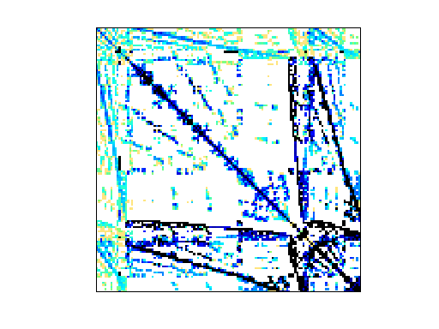
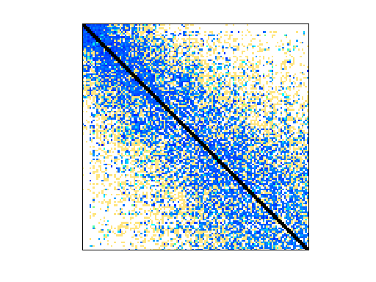
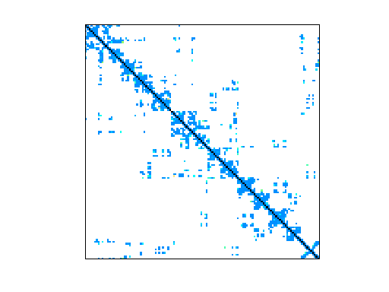
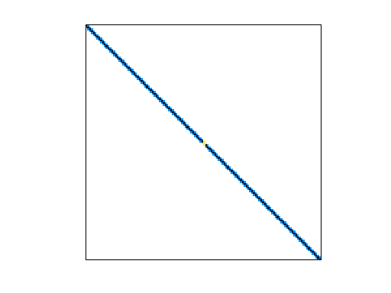
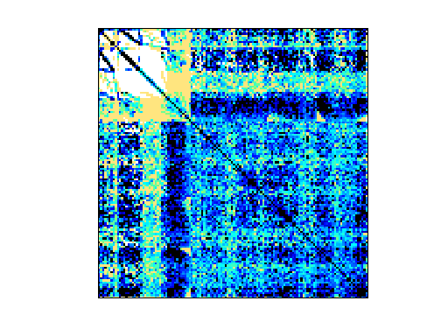
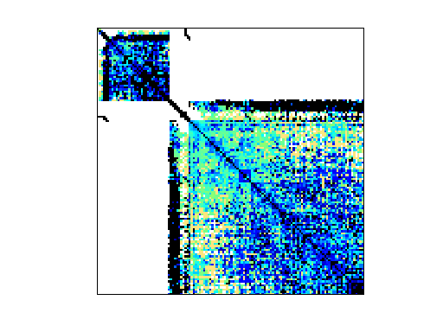
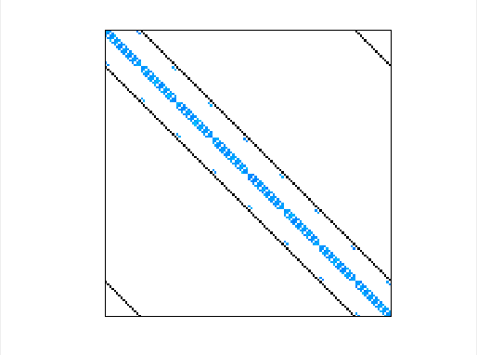
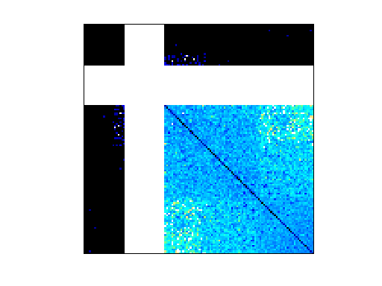
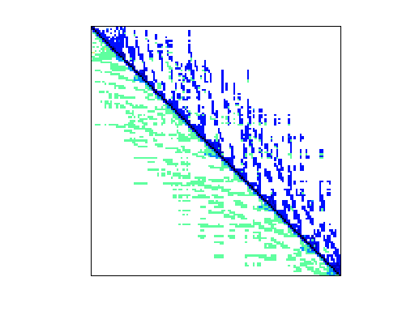
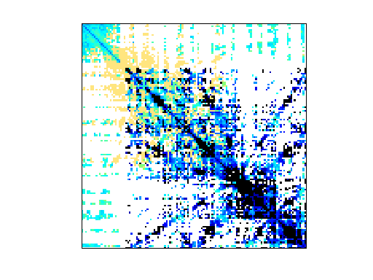
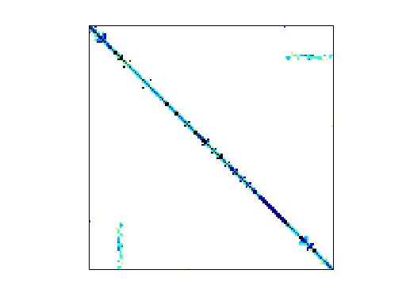
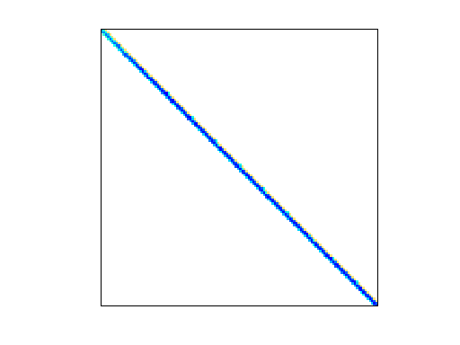
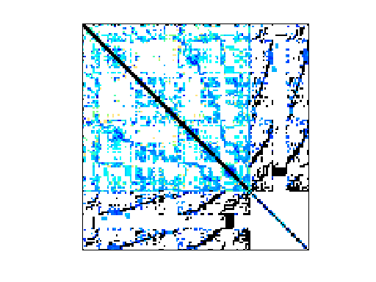
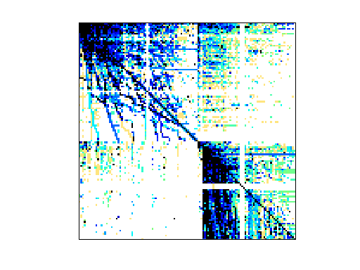
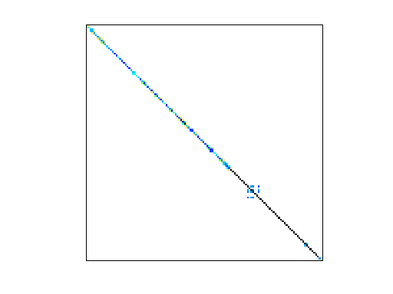
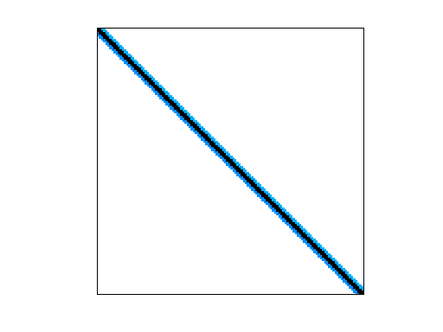
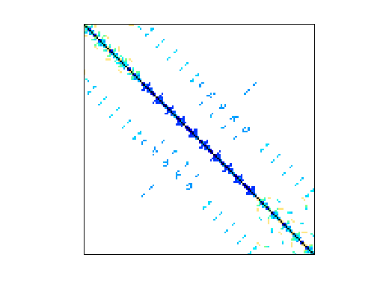
Experimental Setup (Cont.)
dense
crankseq_2
F1
nd24k
pdb1HYS
cant
pwtk
ldoor
qcd5_4
cop20k_A
cage14
2cubes_sphere
atmosmodd
mac_econ_fwd500
scircuit
shallow_water1
webbase-1M
bcsstm38
We select 18 matrices from the University of Florida sparse matrix collection^{[Davis et. al, TOMS11]}
Including structural problem, 2D/3D problem, weighted undirected graph, directed weighted graph, etc.
Notes:
We select 18 matrices from the University of Florida sparse matrix collection. They include both regular and irregular matrices. And those matrices are from various scenarios, like structural problem, 2D/3D problem and so on.

Slide 36
SpMV Performance
Speedup: The overall performance speedup over CSR-MPE
The average speedup ratio is 12.3 ×
The maximum speedup ratio is 15.5 ×
Notes:
This slide shows the SpMV performance of these methods on all datasets. The y-axis is the overall performance speedup over CSR-MPE.
BT-CSR achieves 12.3 times speedup on average.
And the maximum speedup ratio is 15.5.
The big speed-up difference between BT-CSR and other methods is because that BT-CSR can fully explore the advantage of Sunway architecture.

Slide 37
SpMV Performance
BT-CSR achieves the best performance on all datasets
Speedup: The overall performance speedup over CSR-MPE
The average speedup ratio is 12.3 ×
The maximum speedup ratio is 15.5 ×
Notes:
Here we can see that the bt-csr achieves the best performance on all datasets.

Slide 38
Locality
6.50
10.02
7.82
5.85
ratio = memory_accesses^{actu} / memory_accesses^{theo}
Radio, presents the locality inefficiency, lower is better
memory_accesses^{actu}: actual number of memory accesses
memory_accesses^{theo}: theoretical number of memory accesses
Notes:
And this slide shows the locality. The y-axis is the ratio, which presents the locality inefficiency. Lower is better.
This ratio is calculated by the memory_accesses^{the},which is the theoretical number of memory accesses, divided by the memory_accesses^{act}, which is the actual number of memory accesses.
The poor locality of Ellpack for those input datasets is because they are very sparse and need to fill many zeros.
And the better locality of BT-CSR for the datasets is because the BT-CSR can improve the data re-utilization a lot.

Slide 39
Locality
6.50
10.02
7.82
5.85
BT-CSR achieves the best locality on all datasets
ratio = memory_accesses^{actu} / memory_accesses^{theo}
Radio, presents the locality inefficiency, lower is better
memory_accesses^{actu}: actual number of memory accesses
memory_accesses^{theo}: theoretical number of memory accesses
Notes:
Here we can see that BT-CSR achieves the best locality on all datasets

Slide 40
Outline
Background & Motivation
SpMV
Sunway Architecture
Proposed Method
Dual-side multi-level partition mechanism
Example for illustration
Evaluation
SpMV Performance
Locality
Conclusion
Notes:
now, let’s conclude our work.

Slide 41
Conclusion
The first effort of SpMV on Sunway architecture
Take good advantage of architecture features
Can help migrate existing SpMV methods to Sunway
Propose a dual-side multi-level partition mechanism
From both the perspectives of sparse matrix and processor
Multiple levels of data partitions to exploit the locality
BT-CSR, high performance SpMV implementation on Sunway
BT-CSR shows competitive performance
12.3x (up to 15.5x) speedup on Sunway
Reduce the memory traffic a lot
Notes:
Our work is the first effort of spmv on sunway architecture, which can take good advantage of hardware features.
And our method can help migrate existing spmv methods to sunway.
We propose a dual-side multi-level partition mechanism. This is a 3 level partition mechanism from both sides of spmv and sunway processor. We make multiple levels of data partitions to exploit the locality. And we also propose BT-CSR, an application of this mechanism on CSR
BT-CSR shows competitive performance. BT-CSR achieves 12.3 times speedup on average, and reduce the memory traffic a lot.
Multiple partitions competitive

Slide 42
Thanks! Q&A
Notes:
Thanks, and question?

Slide 43
Memory Bandwidth
Max memory bandwidth 26.67 GB/s（dense2）
Average memory bandwidth 21.58 GB/s
Theoretical memory bandwidth is 34 GB/s
Real Bandwidth
Bandwidth base on the data through output of CSR

Slide 44
Sunway architectures
Sunway Architecture
Many-core
Register communication
LDM
Notes:
As we have talked before, that sunway architecture has several features, like many-core , register communication, ldm and so on.
It won’t work well if not utilize the features of it.
Our work propose a dual-side multi-level partition mechanism. It is design for utilize the features of sunway.
We now only migrate csr on Sunway as BT-CSR.
So, it maybe more efficiency to migrate csr5, ellepack on sunway as BT-CSR5. Now, the csr5 version on sunway we implement is just a simplified porting
We could do it in our future work.

